Slide 1
Stochastic Particle Acceleration in High Energy Astrophysical Sources
Siming Liu
University of Glasgow
Collaborators
Vahe’ Petrosian, Yanwei Jiang: Stanford University
Zhonghui Fan: Yunnan University
Oct. 2008 Krakow, Poland

Slide 2
Outline
I: Observations: Distribution
II: Mechanism: Fermi Acceleration
III: Shock Model
IV: Observations: Acceleration Efficiency
V: Stochastic Particle Acceleration Model
VI: Conclusions

Slide 3
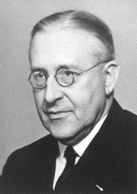
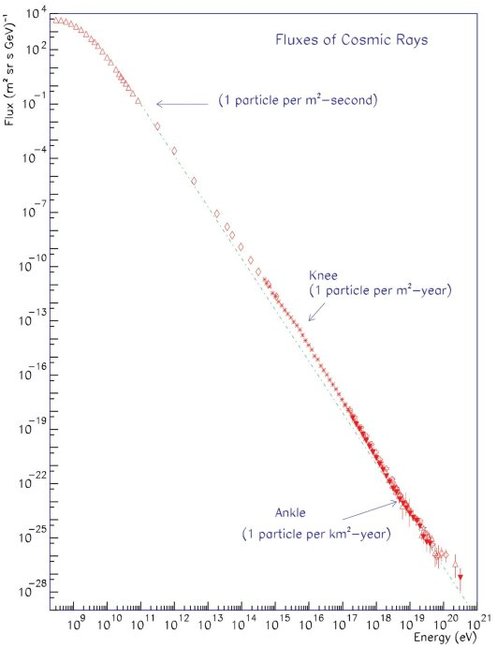
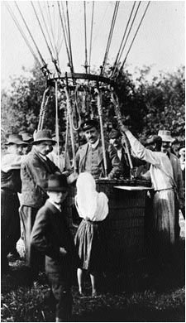
I: Discovery of Cosmic Rays
Victor Franz Hess 1912

Slide 4
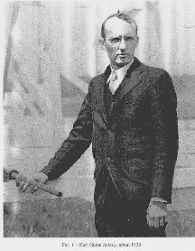
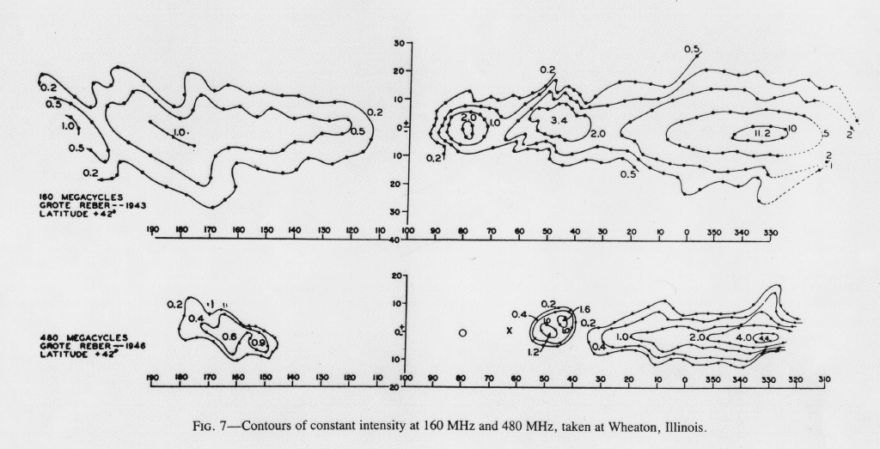
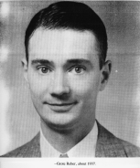
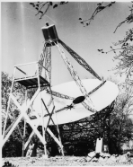
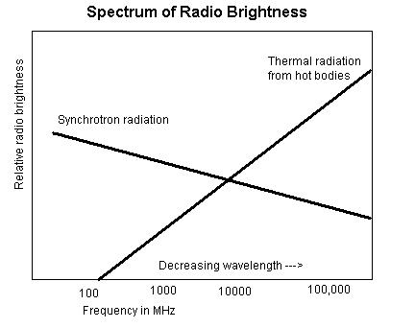
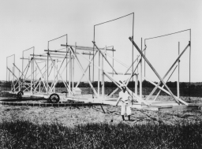
I: Birth of Radio Astronomy
Karl Jansky 1933
Grote Reber 1944

Slide 5
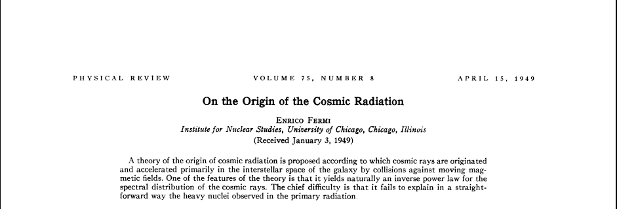
II: Fermi Mechanism
Particles interact with Macroscopic objects
Electro-Magnetic Interaction
But not collisional

Slide 6
III: Shock Model

Slide 7
III: Shock Model
Scattering Mechanism
Injection Problem or Particle Acceleration at Low Energy
Wave Particle Interactions!!!

Slide 8
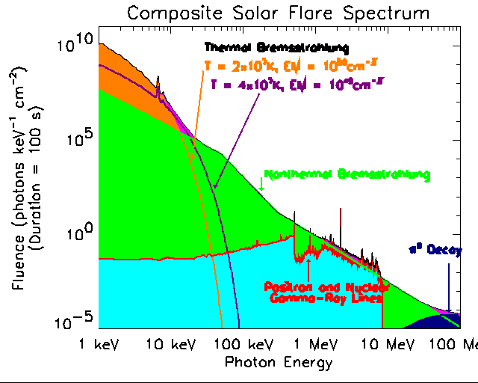
IV: Acceleration Efficiency

Slide 9
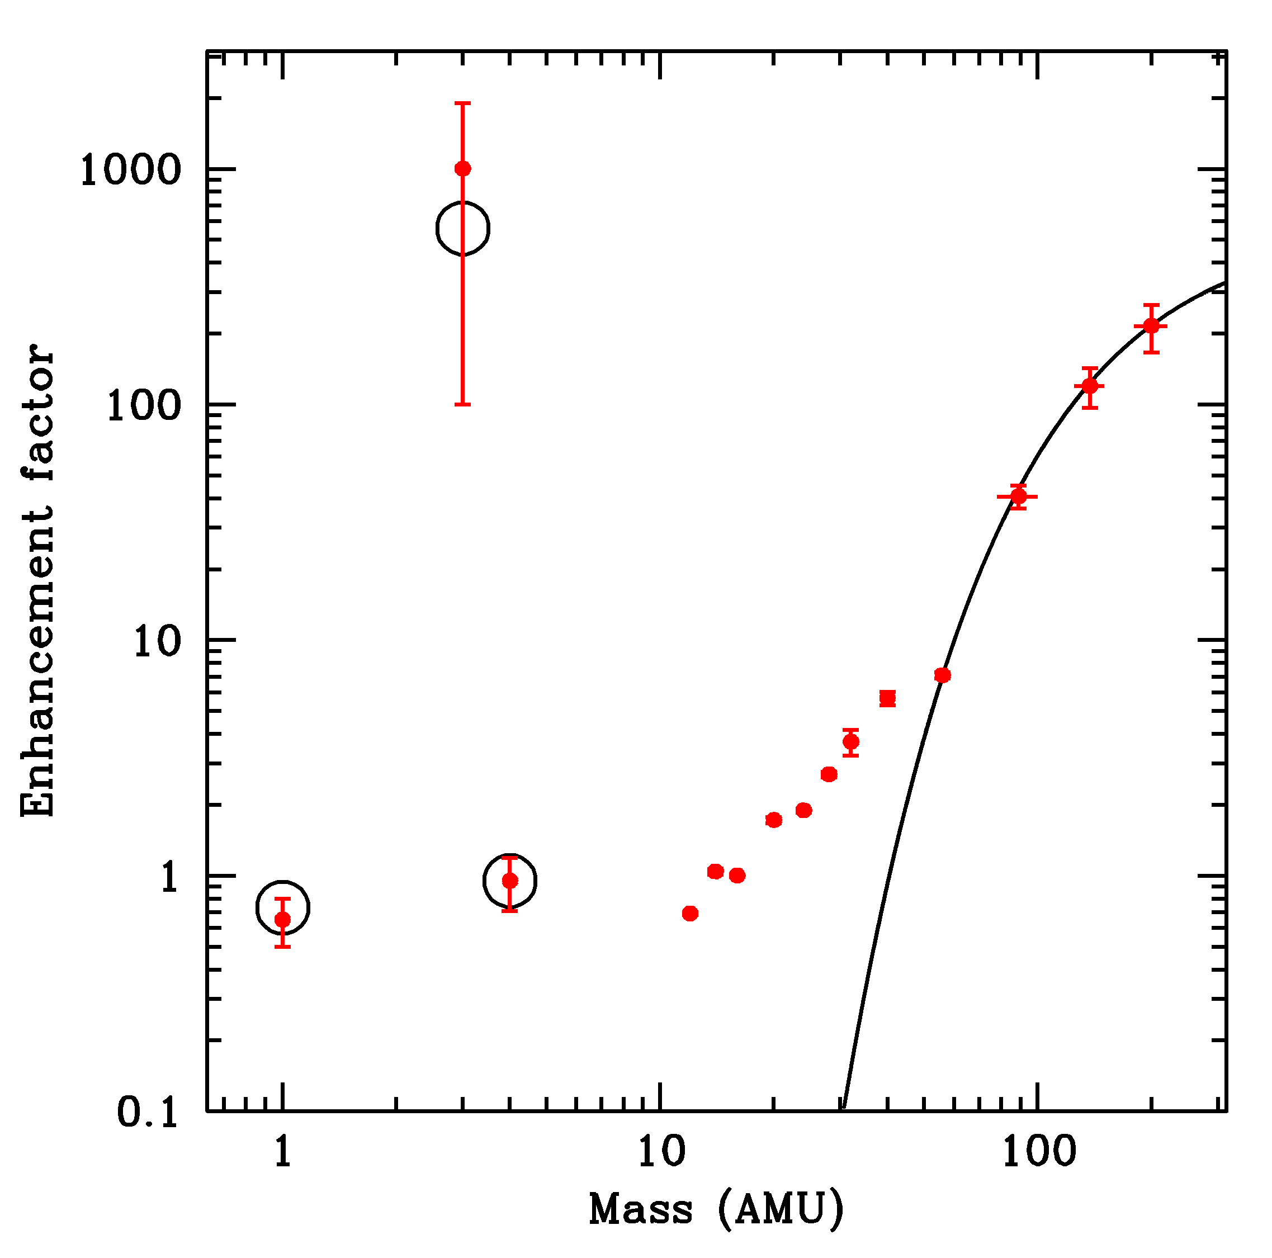
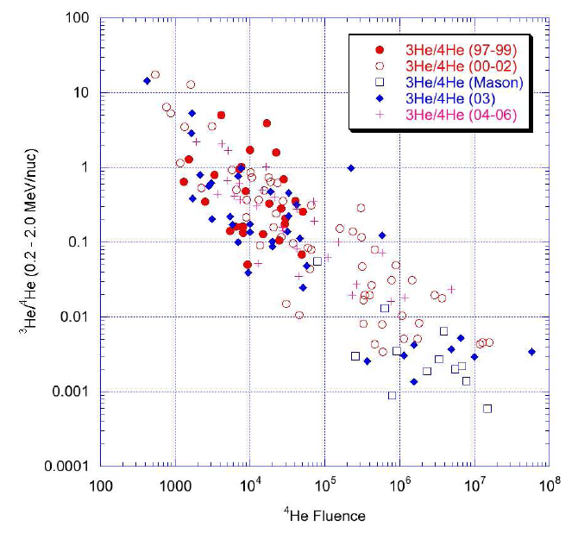
IV: Solar Energetic Ions

Slide 10
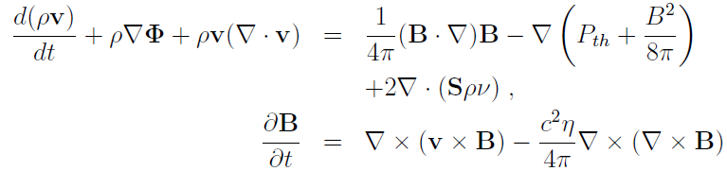
V: Free Energy Dissipation and Turbulence

Slide 11
V: Turbulence Cascade
Kolmogorov
U(L)
U³(L)/L = constant
k~1/L
U(k) ~ k^{-1/3}
ʃ E(k) dk~ U^2(k) ~ k^{-2/3}
E(k) ~ k^{-5/3}
Kraichnan
V>U
U⁴/LV = constant
U(k) ~ k^{-1/4}
ʃ E(k) dk~ U^2(k) ~ k^{-1/2}
E(k) ~ k^{-3/2}

Slide 12
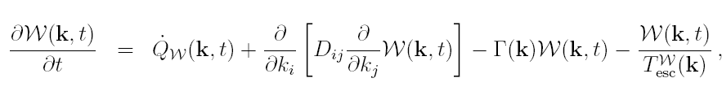

V: Diffusion Approximation
Cascade
Damping
Suppression of turbulence
cascade by wave propagation
ʃ W(k) k²dΩ ~ E(k)
Jiang et al. 2008
Notes:
There is currently no model that can address the magnetic turbulence evolution from the macroscopic scales of turbulence generation to the microscopic dissipation scales self-consistently. This is mostly due to the large dynamical range covered by the system and complicated plasma physics processes involved. The diffusion approximation, which describes the evolution of the turbulence power spectrum with the diffusion equation, can simplify the problem significantly. The physics of magnetic turbulence is mostly carried by the diffusion tensor. Considering the fact that the wave characteristics of magnetic turbulence mostly suppress the cascade by reducing the triple correlation time, the diffusion tensor should be constructed as a function of the wave dispersion relation. Here is an example. The plasma physics processes, including the wave damping, therefore can be treated self-consistently with the exact wave dispersion relation.

Slide 13
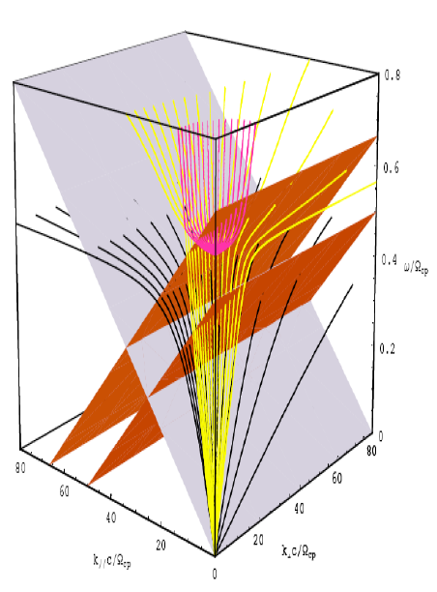
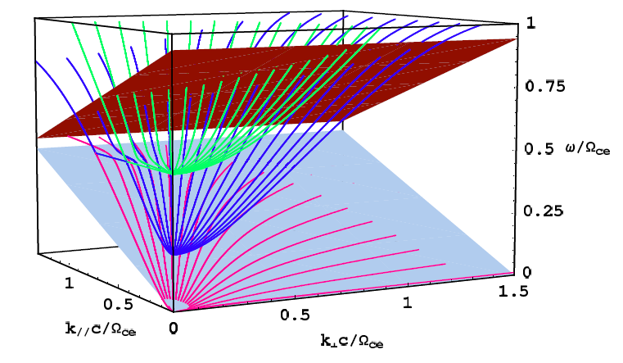
V: Dispersion Relation
Fast Modes
Alfven Modes
Notes:
In general particles can resonate with waves through Laudau damping or cyclotron resonances. Here we show the general wave dispersion relations in a cold plasma and the resonances of electrons and ions near the electron and proton cyclotron frequencies. Clearly the resonant wave-particle interactions depend on the power spectrum of each wave branch.

Slide 14
V: Wave Damping
(WHAMP Code)
He-cyclotron
p-Landau
e-Landau
Notes:
14
Note that the \omg_p in Gary’s paper is proton plasma frequency, so the units is the same with mine.

Slide 15
V: Alfven Wave Cascade
Notes:
15

Slide 16
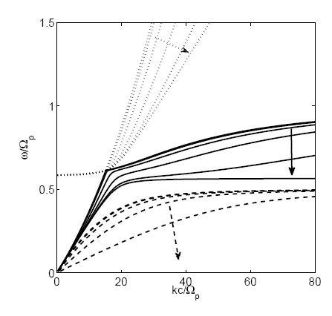
V: Turbulence Cascade Dispersive Effects
MHD regime
Notes:
Skip this slide
16

Slide 17
V: Damping Effects
Jiang et al. 2008
Notes:
Since the damping rate is not isotropic, including the damping makes the steady-state turbulence spectrum anisotropic. The spectrum cuts off at the wave vector, where the damping rate is comparable to the cascade rate. Here we also show how the results depend on the turbulence intensity and plasma beta.

Slide 18

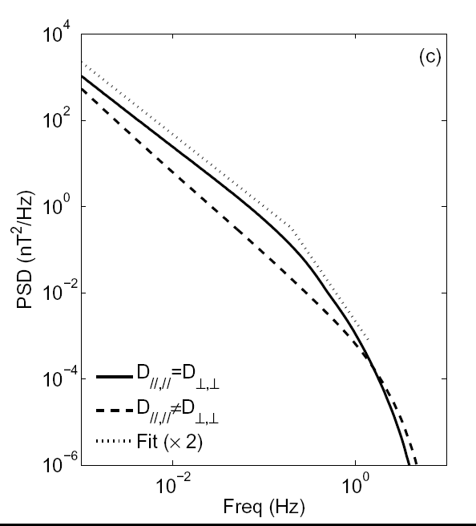
V: Turbulence Cascade and Damping

Slide 19
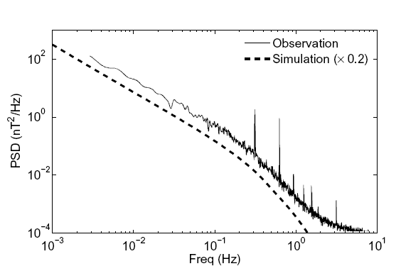
V: Turbulence Cascade and Damping
Observation: (Leamon et al. 1998)‏
Simulation: (Jiang et al. 2008)‏
Notes:
Interestingly the model can naturally explain the broken power-law spectrum of solar wind magnetic turbulence.

Slide 20
V: Dispersion Relation
Notes:
In general particles can resonate with waves through Laudau damping or cyclotron resonances. Here we show the general wave dispersion relations in a cold plasma and the resonances of electrons and ions near the electron and proton cyclotron frequencies. Clearly the resonant wave-particle interactions depend on the power spectrum of each wave branch.

Slide 21
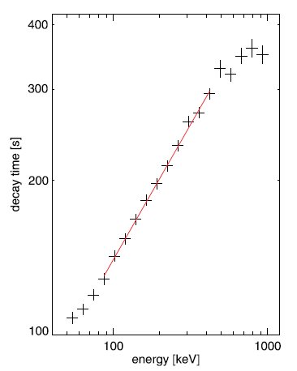
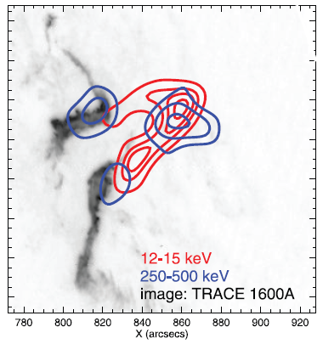
V: Electron-Whistler Resonance

Slide 22
V: Dispersion Relation
Fast Modes
Alfven Modes
Notes:
In general particles can resonate with waves through Laudau damping or cyclotron resonances. Here we show the general wave dispersion relations in a cold plasma and the resonances of electrons and ions near the electron and proton cyclotron frequencies. Clearly the resonant wave-particle interactions depend on the power spectrum of each wave branch.

Slide 23
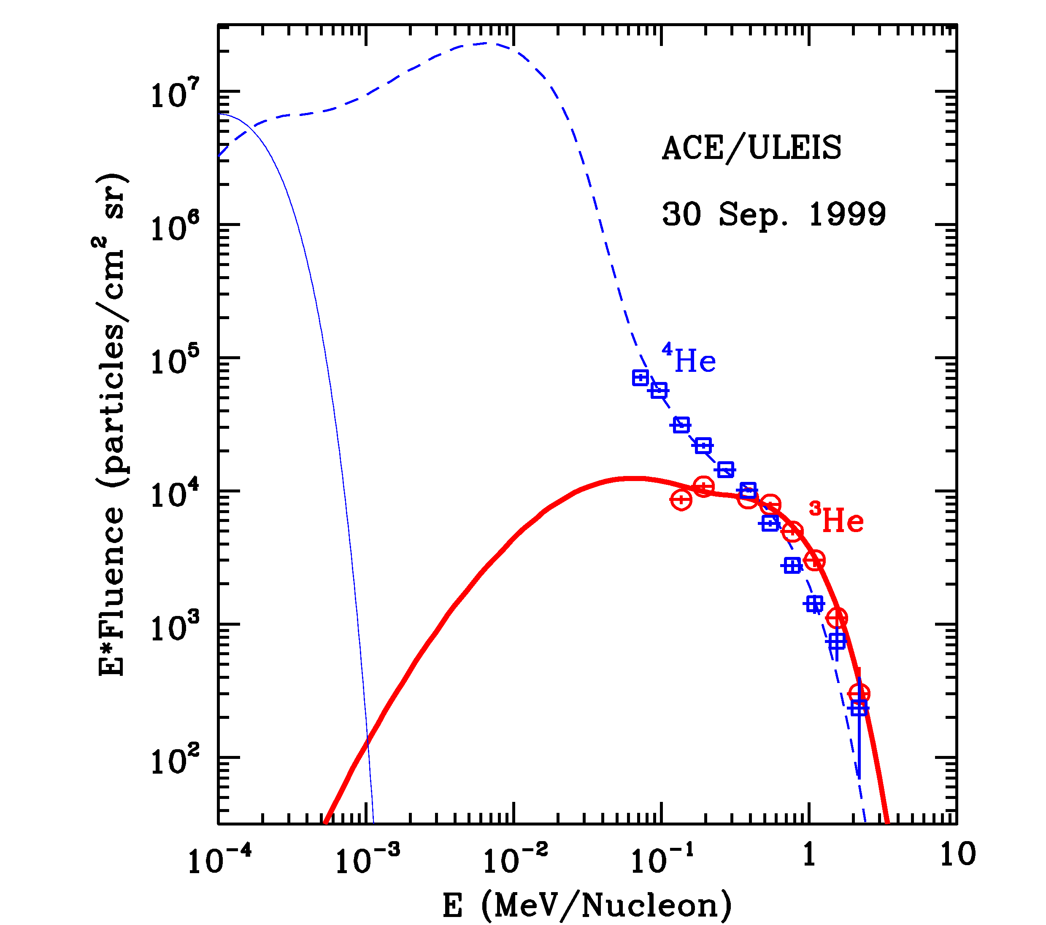
V:3He vs 4He

Slide 24
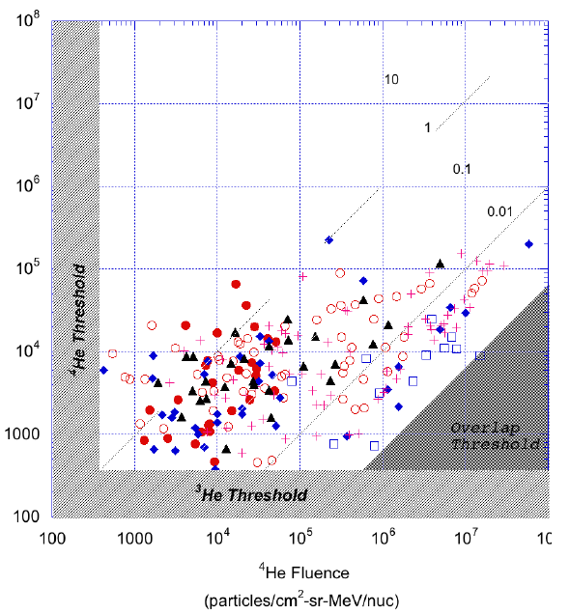
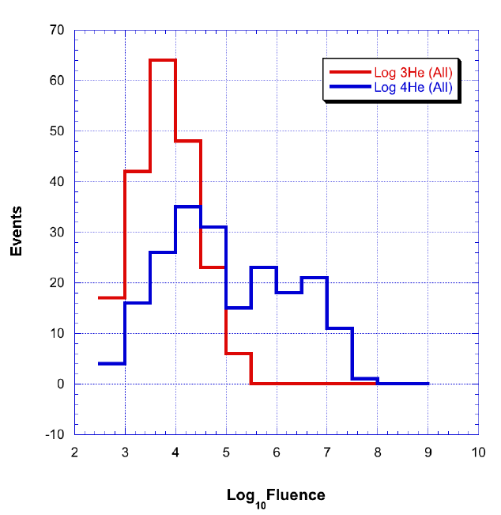
V: 3He vs. 4He

Slide 25
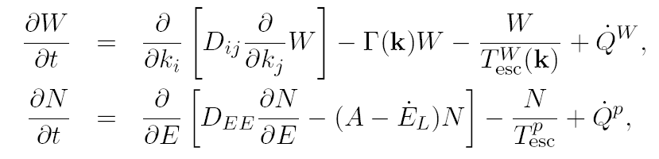
V: A Complete Treatment of
Stochastic Acceleration and Plasma Heating
Jiang et al. 2008
Notes:
To address the particle acceleration by magnetic turbulence self-consistently, one needs to solve the coupled wave diffusion and particle kinetic equations. The damping rates of the waves depend on the particle distributions. The acceleration rates, due to both resonant and nonresonant interactions, depend on the turbulence spectrum. In a full treatment, there will be one diffusion equation for each wave branch and one kinetic equation for each particle specie. There should be another term in the wave diffusion equations to take into account the wave-wave coupling between different branches. These are a quite involved set of equations and may be solved with Monte Carlo simulations.

Slide 26
V: A Complete Treatment of Particle Acceleration in Magnetized Dissipative Plasmas
Acceleration by Large Scale Structure
Shock Waves
Electric Fields
Jiang et al. 2008
Notes:
To address the particle acceleration by magnetic turbulence self-consistently, one needs to solve the coupled wave diffusion and particle kinetic equations. The damping rates of the waves depend on the particle distributions. The acceleration rates, due to both resonant and nonresonant interactions, depend on the turbulence spectrum. In a full treatment, there will be one diffusion equation for each wave branch and one kinetic equation for each particle specie. There should be another term in the wave diffusion equations to take into account the wave-wave coupling between different branches. These are a quite involved set of equations and may be solved with Monte Carlo simulations.

Slide 27
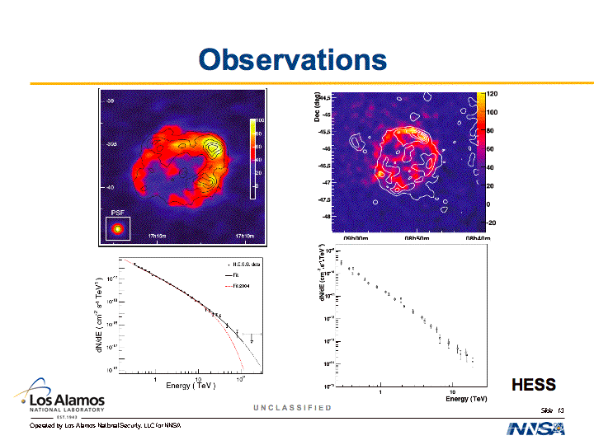
Observations
HESS

Slide 28
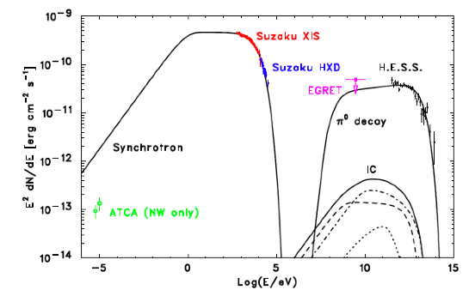
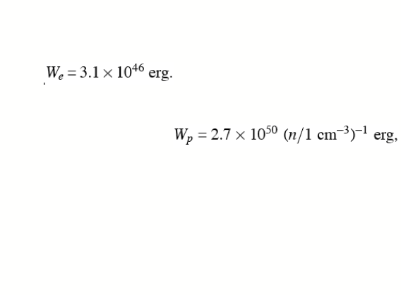
Challenges to the Hadronic Models
No thermal X-rays
Egret upper limit
SNR RX J1713.7-3946
1 Suppression of Electron Acceleration
4 Hard Spectrum with p<2.0
2 High Energy & 3 Density Requirement
Tanaka et al.

Slide 29
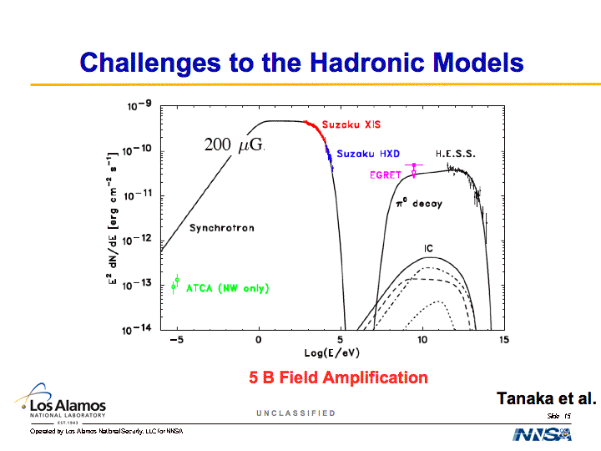
Challenges to the Hadronic Models
Tanaka et al.

Slide 30
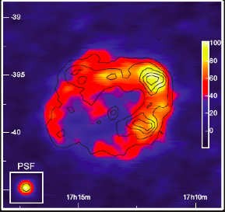
Challenges to the Hadronic Models
6 Lack of Correlation between TeV and Cloud Distribution: Plaga

Slide 31
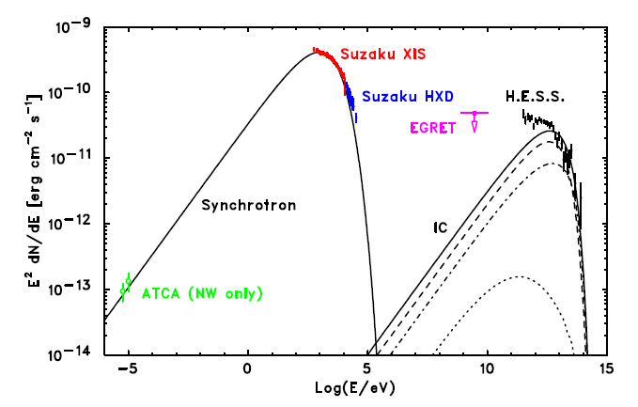
Challenges to the Leptonic Models
1: TeV spectrum too narrow: Background photon? Porter et al.
Tanaka et al.
Notes:
The Leptonic scenario for the TeV emission faces two major challenges. First the model predicted TeV spectrum is not broad enough even after we include contributions from the IR and optical radiation background.

Slide 32
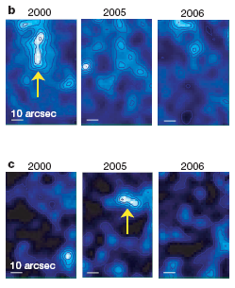
Challenges to the Leptonic Models
Uchiyama et al. 2007
2: Weak B field: Variability?
Tanaka et al.
Notes:
Secondly, with the weak B field inferred from the spectral fitting, it is not obvious how bright filaments with a width of about 0.1 lyr can decay within one year.

Slide 33
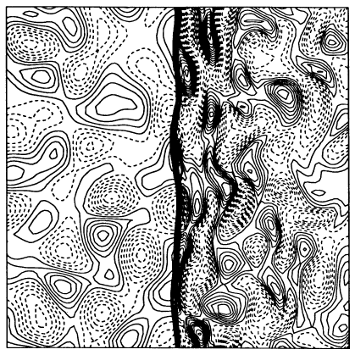
A New Paradigm for Collisionless Shocks
Lee et al. 1994
Notes:
We would like to show here how stochastic electron acceleration by fast mode waves in the downstream of strong non-relativistic shocks overcome these challenges. Here motivated by hydro-dynamical simulations of the interaction of turbulence eddies with shock, we assume that a significant fraction of the shock kinetic energy is converted into turbulence at the shock front and the turbulence then decays as it moves away from the shock front, heating the background plasma and accelerating some particles to very high energies. The contour indicates the vorticity.

Slide 34

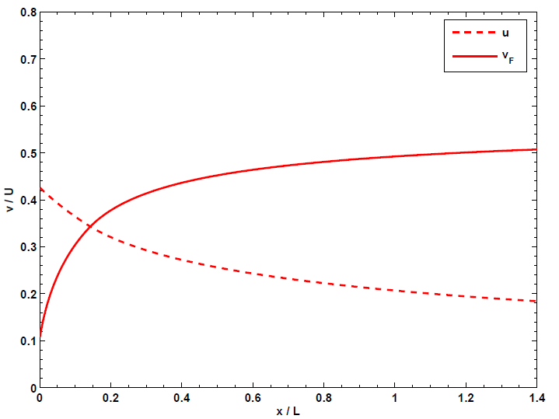

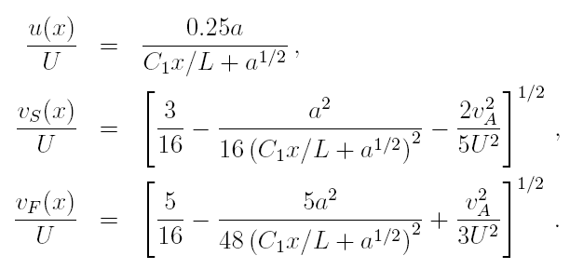
Speed Profiles in the Downstream
Notes:
Ignoring the internal energy of the upstream plasma and the first order Fermi acceleration, from the continuity equations across the shock front, one can obtain this relation for the speeds. Here U is the upstream flow speed in the shock frame; v_S is the isothermal sound speed; u is the eddy speed and v_A is the Alfven speed, v_F is the speed of fast mode waves, which is comparable to the adiabatic sound speed when v_A is much less than v_S. When v_A is much less than U, this figure show the evolution of the eddy speed and speed of fast mode waves in the downstream. Here L is the turbulence generation scale, Q is the free energy dissipation rate through turbulence.

Slide 35

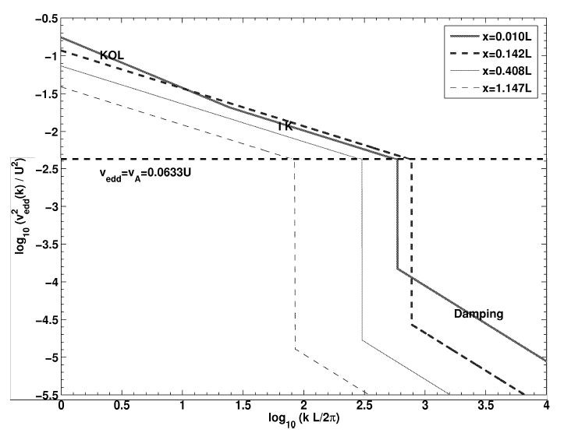



Turbulence spectrum
Notes:
To see how the turbulence heats the background plasma and accelerates particles, we need to consider the cascade of turbulence from the generation scale L to the dissipation range. In the supersonic phase, I.e., u>v_F, the turbulence follows the Kolmogorov phenomenology with a spectral index of 5/3 until it reaches a small scale k_t, where the speed of fast mode waves is equal to the eddy speed. The wave propagation effect will suppress the turbulence cascade on even smaller scales and the turbulence follows the Kraichnan phenomenology with a spectral index of 3/2. At an even smaller scale, the eddy speed is equal to the Alfven speed. The magnetic field becomes coherent and collisionless damping of waves by the background particle sets in.

Slide 36
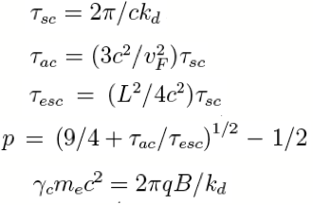
Electron Acceleration by Fast Mode Waves
Notes:
The damping of fast mode waves is dominated by the transit time damping process, which results from resonances of background particles with the parallel component of the wave magnetic field. The damping is most efficient for obliquely propagating waves. Waves propagating along the magnetic field with \theta = 0 do not subject to the damping. Parallel propagating waves will survive the damping and cascade to even smaller scale to accelerate some of the background particles to high energies. Considering the balance between the turbulence cascade and wave damping, one can show the parallel propagating waves in the dissipation range have a power spectral index of 2. For relativistic electrons interacting with these parallel propagating waves through cyclotron resonances, the particle scattering mean free path is equal to the coherent length of the magnetic field and the particle escape time is given by the diffusion time of the particle from the large scale eddy with a size L. Both the acceleration and escape times are independent of energy in this case and one obtains a power-law particle distribution with the power-law index determined by the ratio of the acceleration and escape times. The electron distribution cuts off when the gyro-radius of the particle is equal to the coherent length of the B field. At even higher energies, electrons interact with nearly isotropic fast mode waves, which leads to a gradual high energy cutoff.

Slide 37
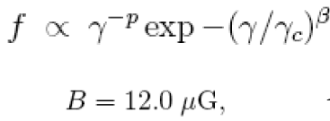
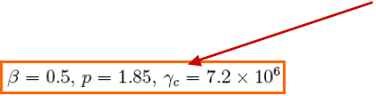
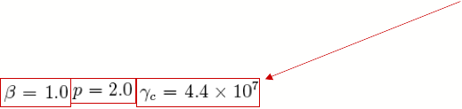
Spectral Fit to SNR RX J1713.7-3946
Notes:
Stochastic acceleration of electrons by fast mode waves therefore produces a power-law electron distribution with a gradual high energy cutoff. With this distribution, we can fit the broadband spectrum of SNR RX J1713.7-3946. The corresponding model parameters are given here. The fitting with a sharp exponential cutoff is not acceptable as shown by the thin lines here. Future observations can distinguish these two models.

Slide 38
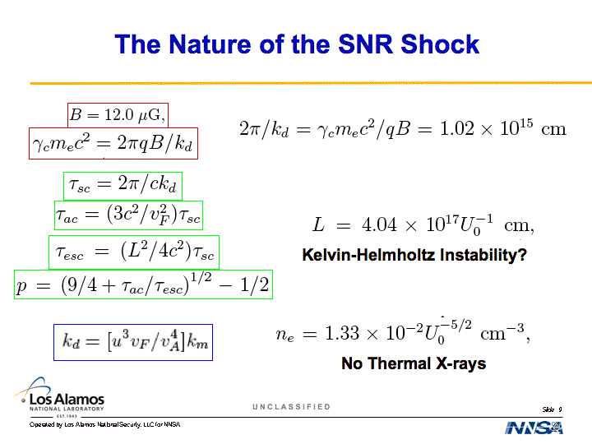
The Nature of the SNR Shock
Notes:
Next we would like to see the implications of these model parameters on the processes near the shock front. First from the B field and cutoff energy, we obtain the coherent length of the B field which is about 10 to the 15 cm. Combining this with the particle spectral index, we determine the turbulence generation scale of about half a light year. This scale is much longer than the ion inertial length and the electron skin depth. The turbulence therefore is likely generated by certain large scale hydrodynamical instability. The Kelvin-Helmholtz instability of shearing flow is one possible mechanism. With the turbulence generation scale and the coherent length of the B field, one obtains the Aflven speed, which implies a density of 0.01. We therefore don’t expect thermal X-rays.

Slide 39
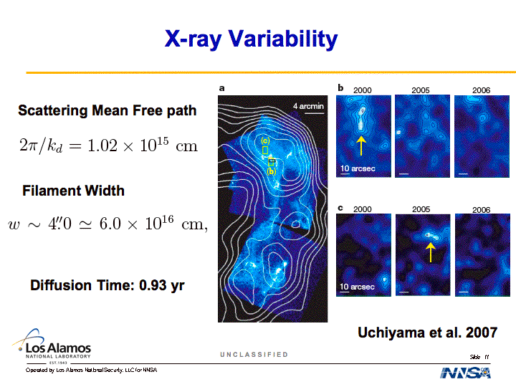
X-ray Variability
Uchiyama et al. 2007
Notes:
We have already shown how the stochastic electron acceleration accounts for the broad TeV spectrum. How to account for the X-ray variability then? The rising phase of the brightening filament may be attributed to inhomogeneity in the upstream flow. The decay can be attributed to spatial diffusion of high energy electrons from bright regions. The scattering mean free path of the electrons is about 10^15 cm. The width of the filament is about 6 times 10^16. The corresponding diffusion time is less than one year.

Slide 40
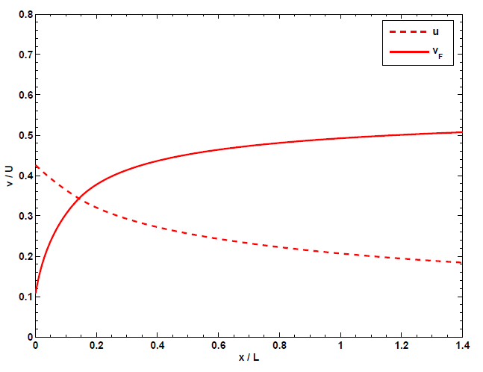

Slide 41
Turbulence spectrum
Notes:
To see how the turbulence heats the background plasma and accelerates particles, we need to consider the cascade of turbulence from the generation scale L to the dissipation range. In the supersonic phase, I.e., u>v_F, the turbulence follows the Kolmogorov phenomenology with a spectral index of 5/3 until it reaches a small scale k_t, where the speed of fast mode waves is equal to the eddy speed. The wave propagation effect will suppress the turbulence cascade on even smaller scales and the turbulence follows the Kraichnan phenomenology with a spectral index of 3/2. At an even smaller scale, the eddy speed is equal to the Alfven speed. The magnetic field becomes coherent and collisionless damping of waves by the background particle sets in.

Slide 42
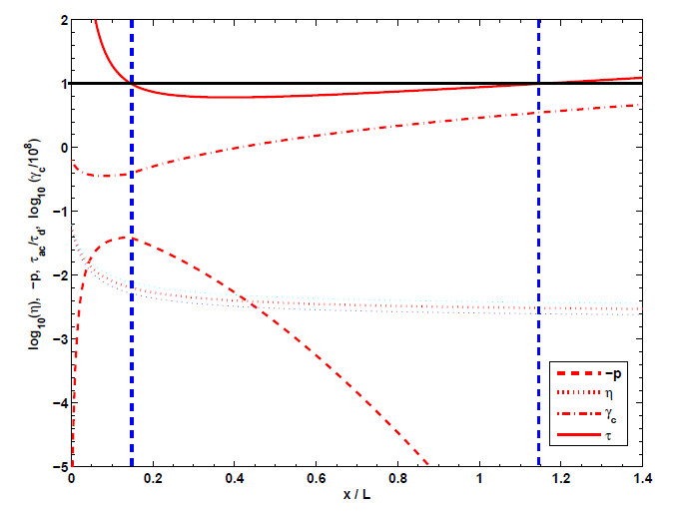

Slide 43
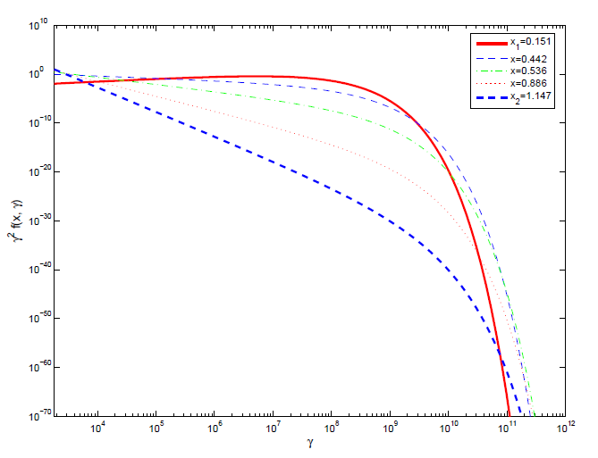

Slide 44
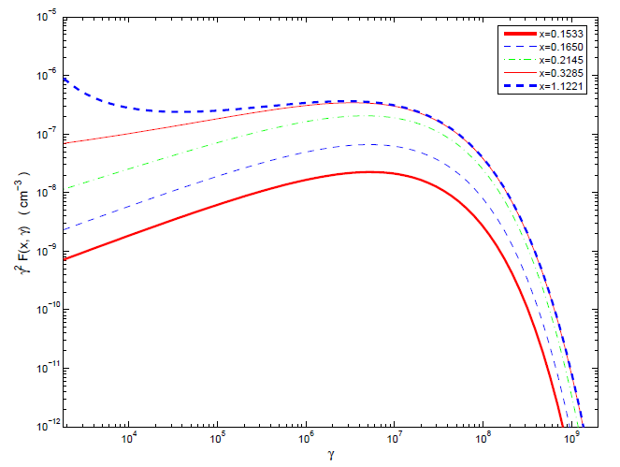

Slide 45
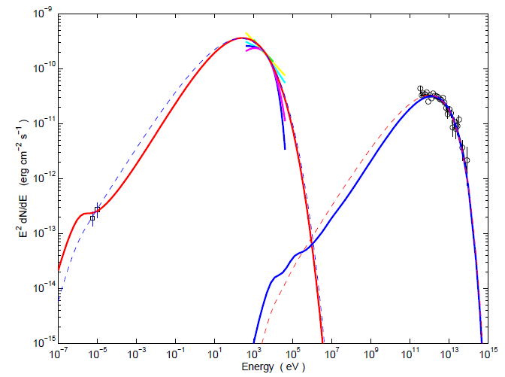

Slide 46
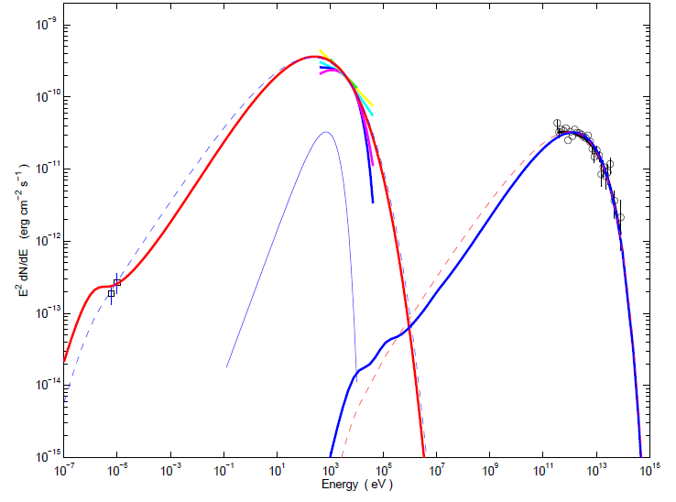

Slide 47
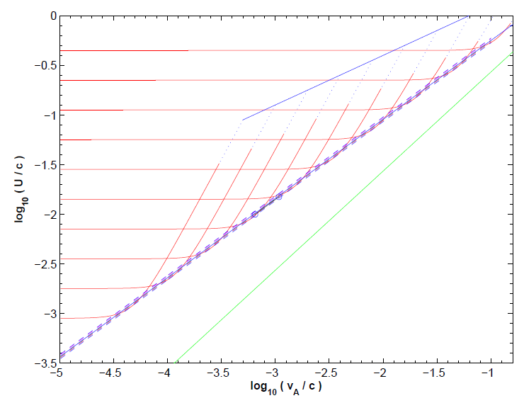

Slide 48


Slide 49


Slide 50


Slide 51
VI. Conclusions
Plasma Wave Turbulence is
an important channel for the release of free-energy in high energy astrophysical sources
Stochastic Acceleration by it can lead to a quantitative treatment of plasma heating and acceleration of non-thermal particles

